Slide 2
 |  | True
 |  | Impaired | Normal
Pred | Impaired | 36 | 19
 | Normal | 12 | 33

Slide 3
 |  | True
 |  | Impaired | Normal
Pred | Impaired | 35 | 16
 | Normal | 17 | 36
 |  | True
 |  | Impaired | Normal
Pred | Impaired | 34 | 24
 | Normal | 18 | 32

Slide 4
 |  | True
 |  | Impaired | Normal
Pred | Impaired | 30 | 11
 | Normal | 14 | 45

Slide 5
 |  | True
 |  | Impaired | Normal
Pred | Impaired | 31 | 9
 | Normal | 13 | 47

Slide 6
 |  | True
 |  | Impaired | Normal
Pred | Impaired | 45 | 17
 | Normal | 11 | 27
 |  | True
 |  | Impaired | Normal
Pred | Impaired | 45 | 16
 | Normal | 11 | 28

Slide 7
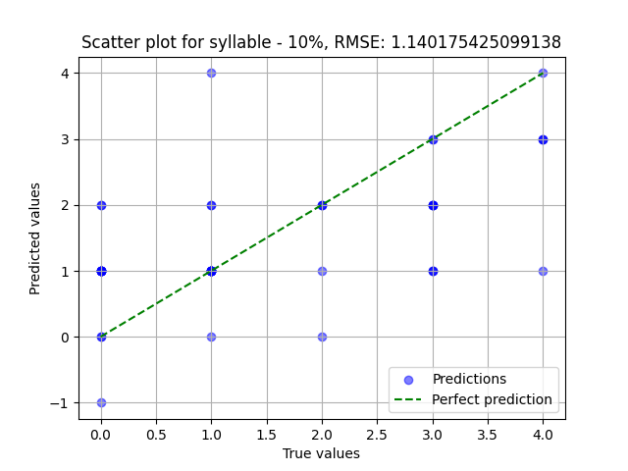

Slide 8
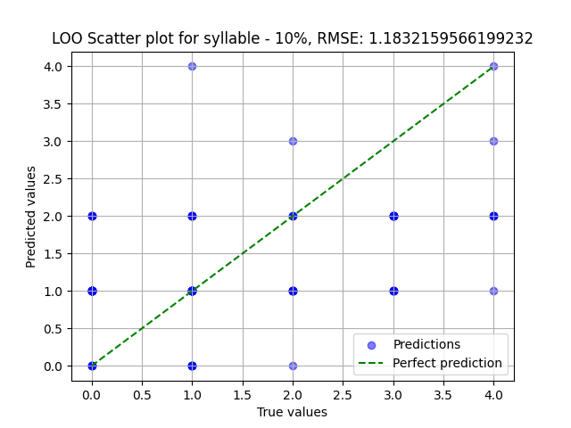

Slide 9
Features | p-value
number_of repetitons_k number_of repetitons_p number_of repetitons_t tot_articulation_p tot_articulation_t tot_articulation_k duration_i duration_k duration_o mfcc_5_k duration_a duration_u duration_p f0_std_t duration_e f0_std_p duration_t mfcc_1_t mfcc_1_p | < 0.001
f3_min_i f1_std_e f3_mean_i f2_min_k f2_mean_u mfcc_0_t f2_median_u f1_std_p f1_min_p f1_std_o mfcc_3_p | < 0.01
f1_std_i VOT_p mfcc_0_p mfcc_1_k mfcc_11_p f0_std_k … | < 0.05
Features | p-value
number_of repetitons_k number_of repetitons_p number_of repetitons_t tot_articulation_k tot_articulation_p duration_k tot_articulation_t mfcc_5_k duration_t duration_p duration_o duration_e duration_i VOT_p duration_a f2_mean_u f2_std_o duration_u f1_std_e mfcc_1_p | < 0.001
f2_median_u mfcc_1_t f1_std_o mfcc_5_t shimmer_apq11_o f2_mean_i VOT_t f1_std_p f0_std_k f0_std_t mfcc_0_k f2_max_p hnr_max_p … | < 0.01
mfcc_1_k f2_mean_p f0_std_o … | < 0.05
Features | p-value
mfcc_1_t mfcc_0_k mfcc_12_k mfcc_0_t mfcc_1_p duration_k mfcc_0_p f2_median_o number_of repetitons_k low_energy_t mfcc_12_p VOT_p number_of repetitons_p number_of repetitons_t | < 0.001
f2_mean_u duration_t mfcc_5_a mfcc_1_k mfcc_8_k f2_median_u f2_min_u mfcc_4_k mfcc_11_t duration_p tot_articulation_p f2_mean_o f2_median_p mfcc_11_e mfcc_5_t | < 0.01
hnr_std_i tot_articulation_k f2_mean_p mfcc_1_a tot_articulation_t mfcc_5_k mfcc_4_e … | < 0.05

